Slide 1
Movies take us away from life.
Enjoy each other, live life!

Slide 2
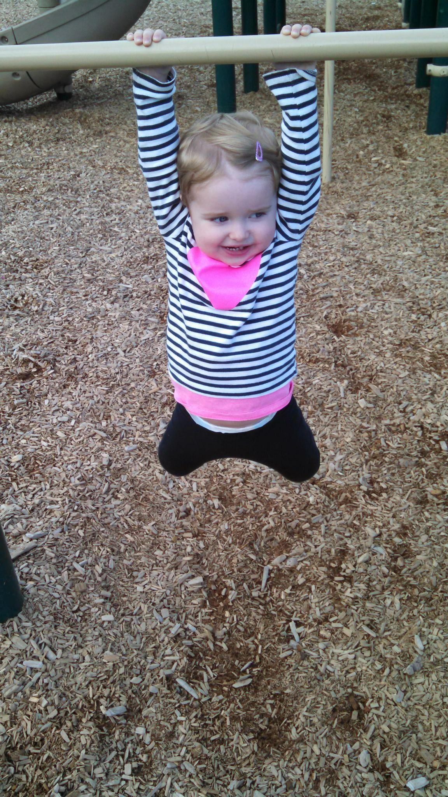
Maybe some pull ups at your local playground

Slide 3
Maybe some pull ups at your local playground

Slide 4
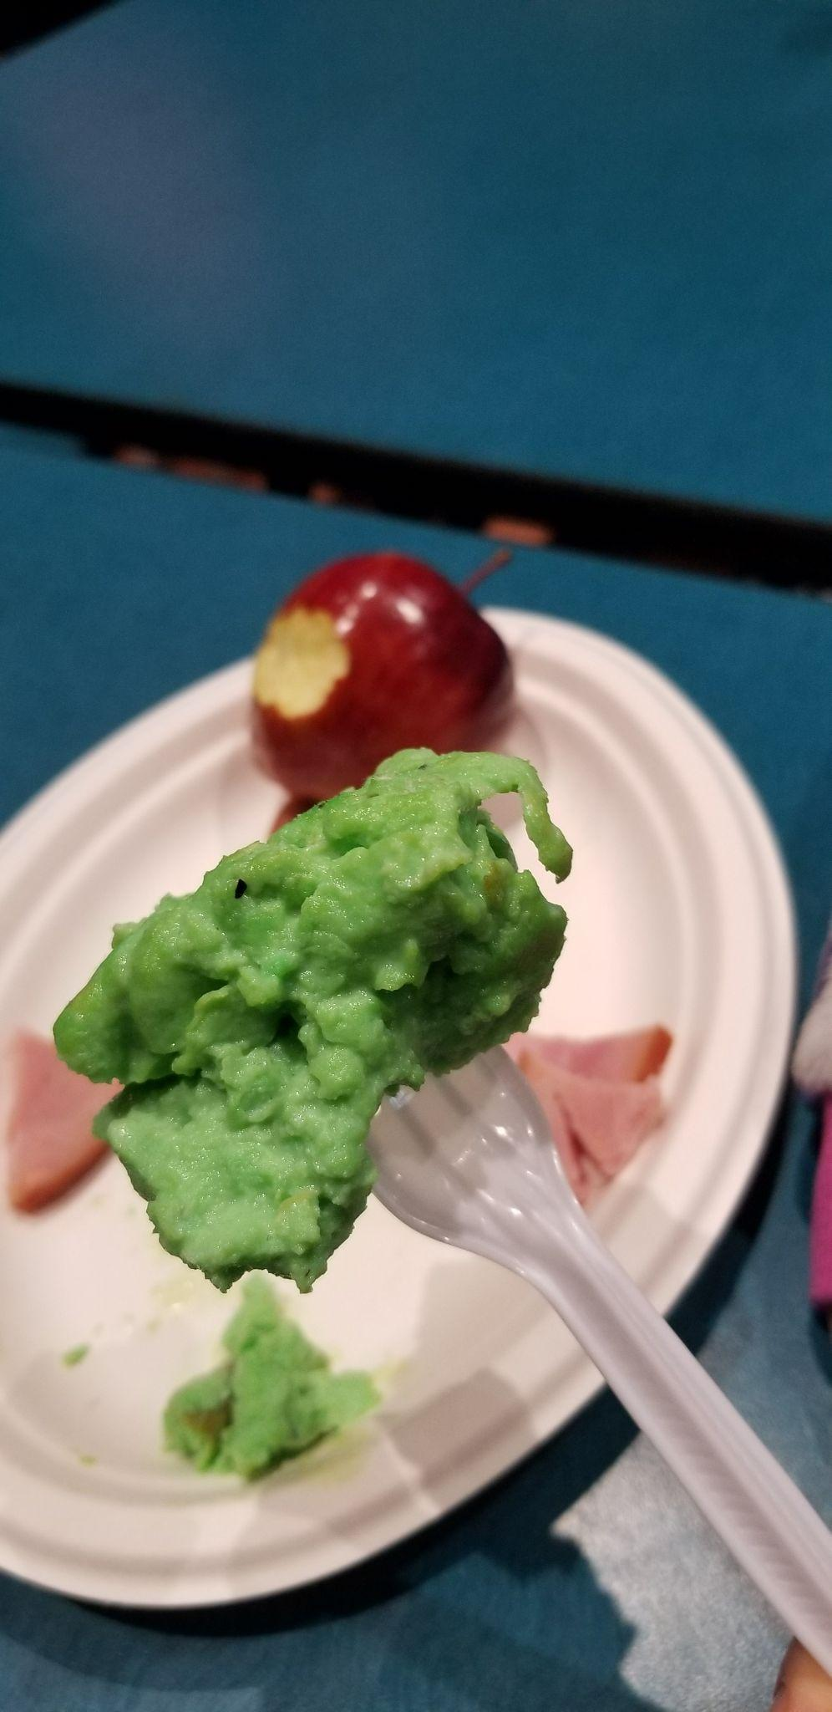
Maybe you want to try your culinary skills

Slide 5
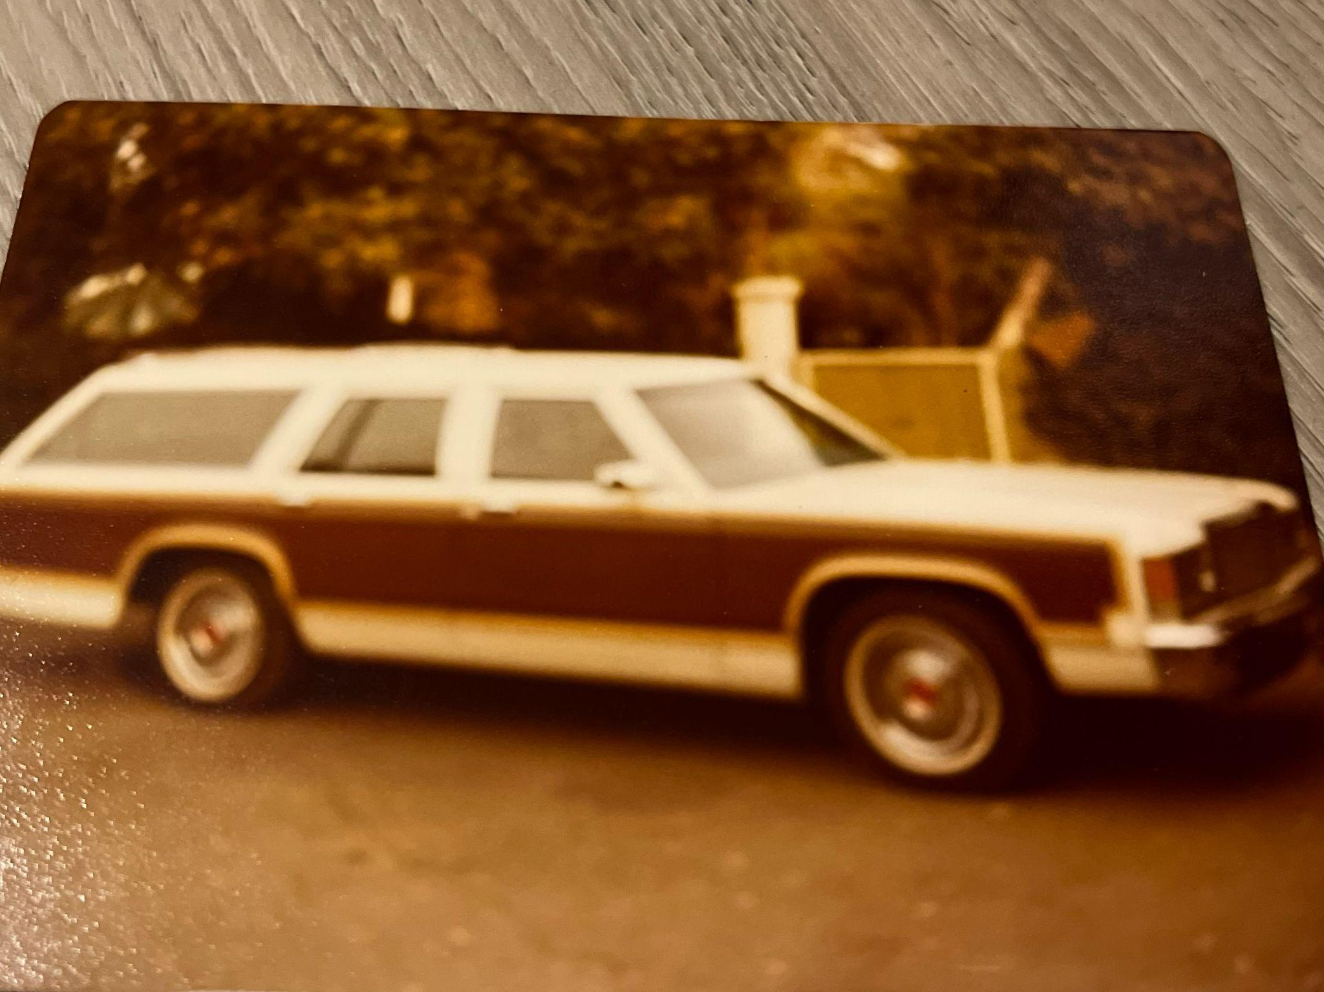
Go on an adventure!

